Slide 1
Business Intelligence Concepts, Tools, and Applications
Week 3: Data Visualization and Dashboard Design
Lesson 1: Data Visualization

Slide 2
Data Visualizations
Learning Objectives
Define data visualization.
Identify different types of data that can be visually represented.
List types of basic and composite charts and compare and determine which is most effective to display data associated with unique case studies

Slide 3
Data Visualization
Companies and individuals increasingly rely on data to make good decisions.
Because data is so voluminous, there is a need for visual tools that help people understand it.
Data or information visualization
is the use of visual representations to explore, make sense of, and communicate data.
What is portrayed in data visualizations
is the information (aggregations, summarizations, and contextualization) and not the data.
Notes:
In this course we are more focus the use of data visualization for business intelligence purposes

Slide 4
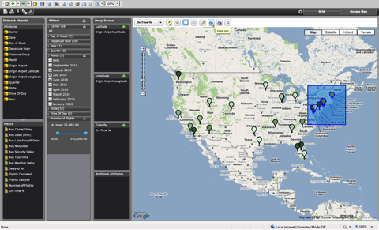
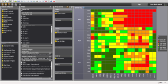

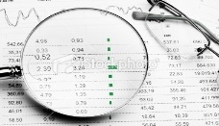
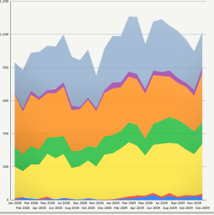


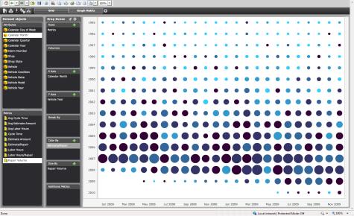
Visual Data Discovery Empowers Business People to Conduct Analysis without IT Help
Start
Visual Data Discovery
Finish
Data
Analyze & Explore
Insight
Familiarize
Visualize
Notes:
A good way to think about Data Discovery is Self Service 2.0. Let me explain.
Slide
Data discovery is an emerging style of BI that empowers Business people to conduct their own analysis without help from IT. For business people it is a brand new BI experience from going from data to Business insight.
There are three layers in data visualizations in a data Visualization Framework that helps us understand how data is processed for visualization.
Data Layer
•Locating and obtaining data
•Importing data in proper format
•Relating data for proper correspondence
•Data analysis and aggregation
Mapping Layer
• Associating appropriate geometry with corresponding data channels
• Data analysis and algorithms (e.g. contouring)
Graphics Layer
• Conversion of geometry into displayable image
•Decorations
• Managing interaction
You start with data. That data can be managed data from database or it can be your own data in spreadsheets. It’s up to you.
You start by familiarizing yourself with the data. You can look into the data and begin to understand any relationships.
Next, you can apply visualizations to that data to help you discern patterns, problems, and trends.
You can apply your own analysis to this by filtering the data, creating new calculations, and adding views of the data.
But truthfully, the data discovery process is not so linear. At any time you can add new visualizations, add new combinations of data, and refine your data analysis.
Until you arrive at the business insight.
Data Discovery is an exploratory and iterative process. That exploratory process is highly visual. A good way to describe it is Visual OLAP. It’s a better way for many people to understand data than the classic OLAP tabular format. And business people can do all this on their own without help from IT. At the same time, IT can make sure this can securely deploy at scale and with high performance.

Slide 5
Types of Data
Nominal Attributes Data that be counted, but not ordered or aggregated. Examples: •Products – Books, Movies, Music •Gender – Male, Female •State – Virginia, Nevada, California | Ordinal Attributes Data that can be counted and ordered, but not aggregated. Examples: •Date – 1/1/2014, 1/2/2014… •Grades – A, B, C… •Ranks – Like, Neutral, Dislike
Metrics Quantitative data that can be counted, ordered, and aggregated. Examples: •Revenue, Cost, Profit •Number of Customers •Temperature •Time | Ordinal Attributes and Metrics Some data can be used as either attributes or metrics. Their classification is dependent on usage. Examples: •Age •Scores
Adopted From Best Practices in Data Visualization, by Vihao Pham 2014
Notes:
From Best Practices in Data Visualization, by Vihao Pham 2014

Slide 6
There Are Five Categories of Data Comparison
1
COMPONENT (CONTRIBUTION)
Share
Percentage of total
Accounted for X percent
Size
Percentage of a total
Rank
Larger than / Smaller than
More / Less
Equal / Same
2
ITEM
Ranking of items
3
Change / Grow
Rise / Decline
Increase / Decrease
Fluctuate
TIME SERIES
Changes over time
4
FREQUENCY DISTRIBUTION
Concentration
X-to-Y range
Frequency
Distribution
Items within ranges
5
Relationships between variables
Related to
Increases / Decreases with
Changes / Varies with
Does not increase with
CORRELATION
Source: Adapted from Gene Zelazny (2001). Say It With Charts
Notes:
From Zelazny, G. Saying It With Charts: The executive's Guide to Visual Communication McGraw Hill Professional, March 15, 2001

Slide 7
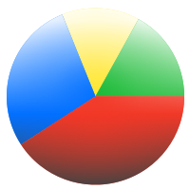
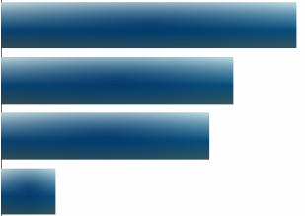
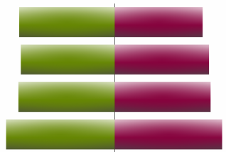
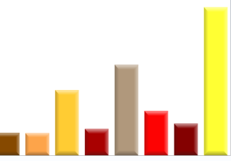
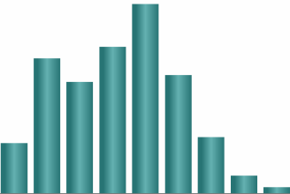
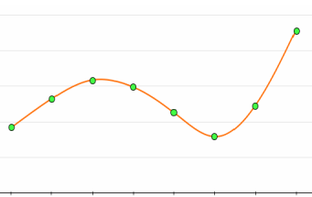
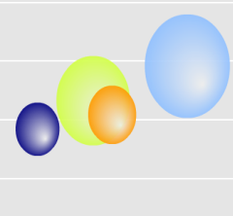
This Chart-Comparison Matrix Identifies the Best Chart Type to Maximize Data Comprehension
Comparison Type
COMPONENT
ITEM
TIME SERIES
FREQUENCY
CORRELATION
PIE
BAR
Basic Chart Form
COLUMN
LINE
Source: Adapted from Gene Zelazny (2001). Say It With Charts
Adopted from Zelazny, G. Saying It With Charts: The executive's Guide to Visual Communication McGraw Hill Professional, March 15, 2001
DOT
Notes:
Adopted from Zelazny, G. Saying It With Charts: The executive's Guide to Visual Communication McGraw Hill Professional, March 15, 2001
According to Zelazny, “it’s not the data or measure that indicate which chart to use; it’s what you say about it.”

Slide 8
In Most Cases, One of Five Basic Chart Types Provides the Most Effective Data Presentation
Recommended usage frequency
Pie Chart
5%
Bar Chart
25%
Recommended usage frequency
Column Chart
50%
Recommended usage frequency (combined)
Line Chart
Dot Chart
10%
Recommended usage frequency
Source: Adapted from Gene Zelazny (2001). Say It With Charts
Notes:
From Zelazny, G. Saying It With Charts: The executive's Guide to Visual Communication McGraw Hill Professional, March 15, 2001

Slide 9
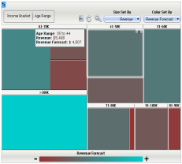
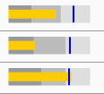
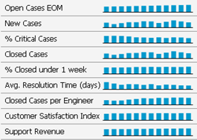
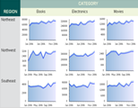
Composite Charts Convey More Business Dimensions and Metrics into a Single Display
Pie Chart
Heat Map
Bar Chart
Bullet Graph
Column Chart
Micro Chart
Line Chart
Graph Matrix
Dot Chart
Bubble Chart
Source: Adapted from Gene Zelazny (2001). Say It With Charts

